Slide 1
Gesture-Controlled JetBot
Project by:
Kulin Patel
Harsh Shroff
Vishnu Vardhan Reddy Putha
DATA 690 - Advanced AI
Prof. Len Mancini
University of Maryland, Baltimore County

Slide 2
Project Overview
Objective of the project: "Enhancing the capabilities of JetBot by implementing an intuitive gesture control system.“
Key Features: "Control movement in the forward, backward, left, and right directions using hand gestures.“

Slide 3
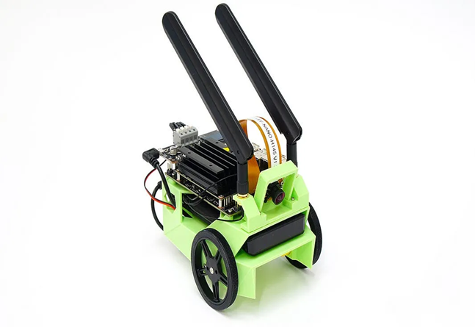

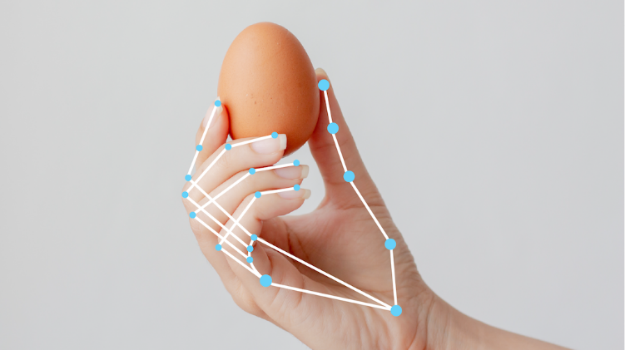
Technical Components
Technologies: MediaPipe and OpenCV for Gesture Recognition
Processing Unit: Jetson Nano – The Brain Behind the Operation
Communication: TCP Socket for Seamless Computer-Jetson Interaction

Slide 4
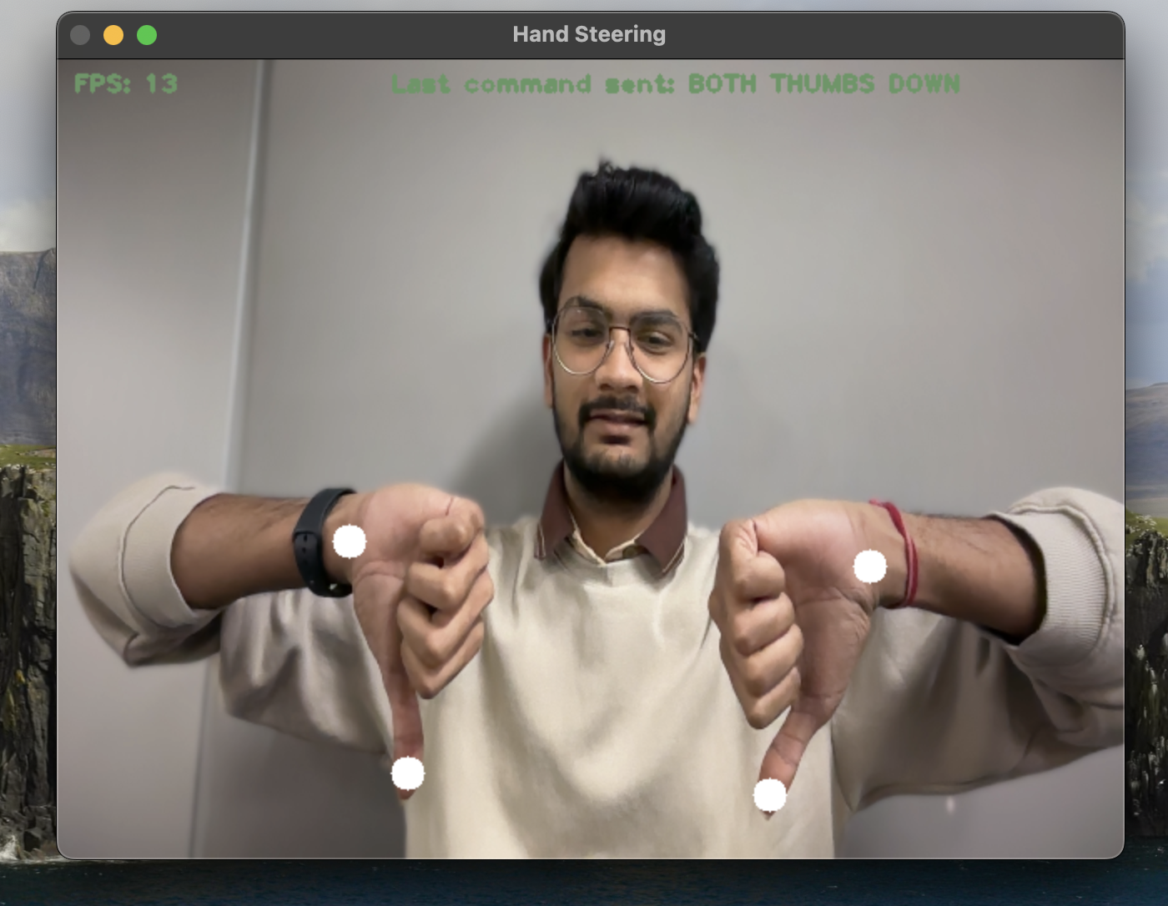
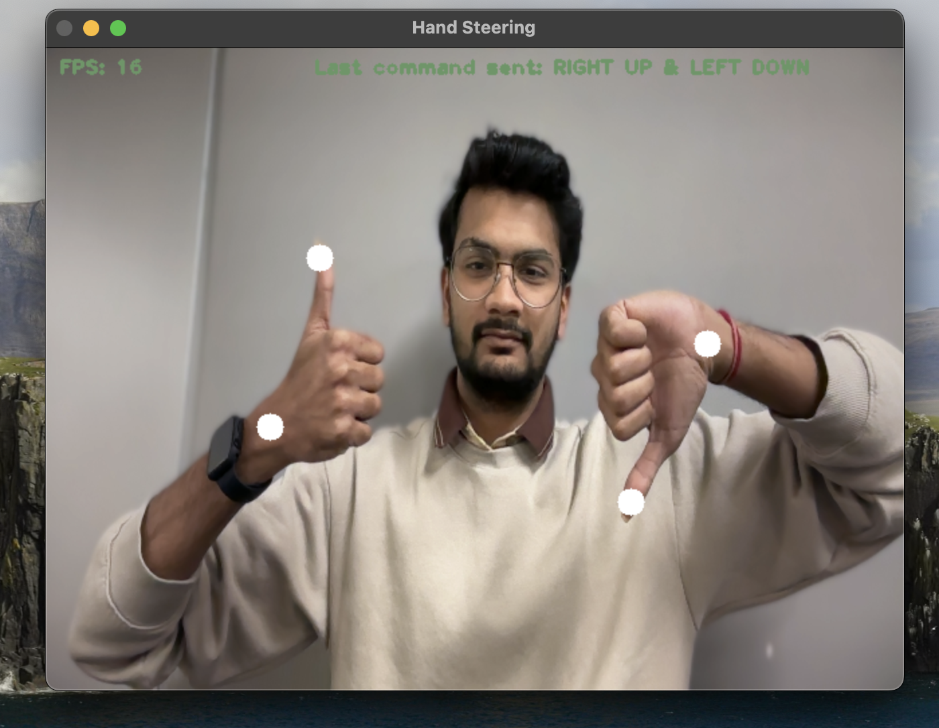
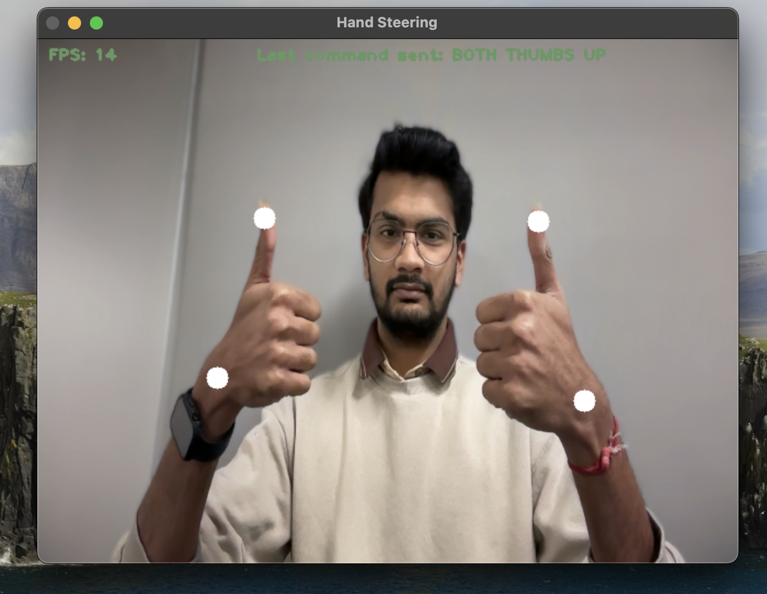
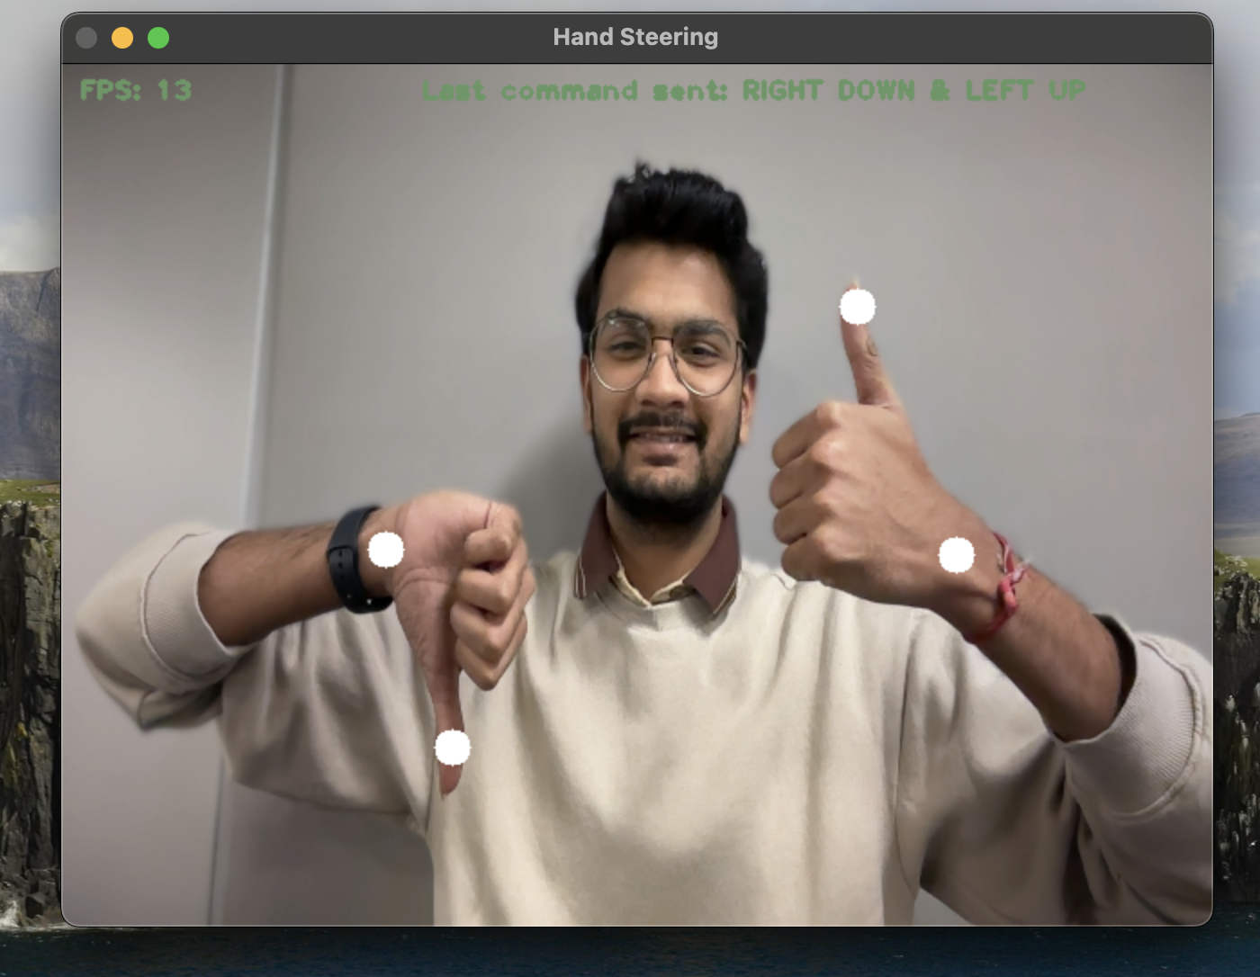
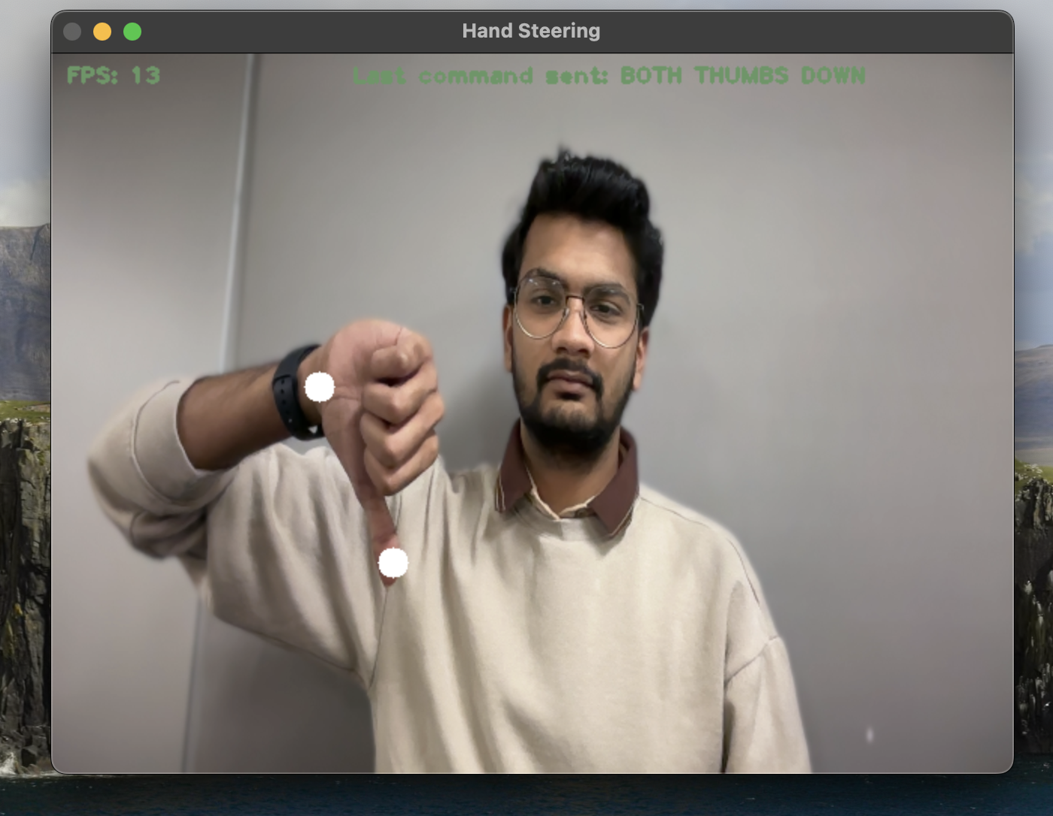
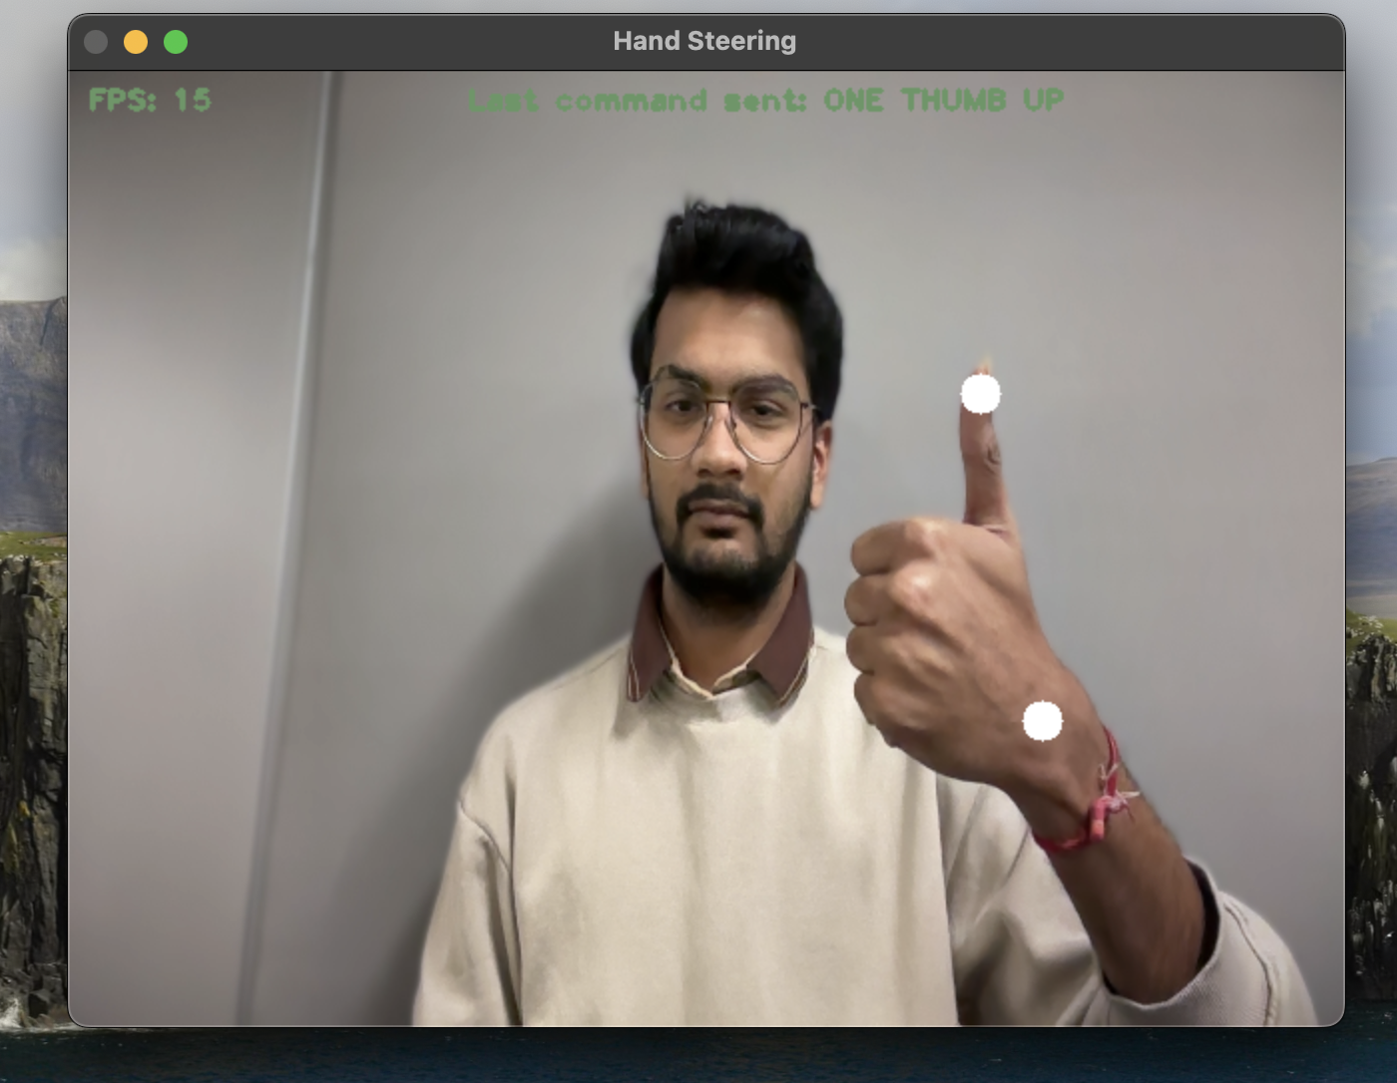
Hand Gestures
Left Turn
Forward
Backward
Right Turn
Quick Left
Quick Right

Slide 5
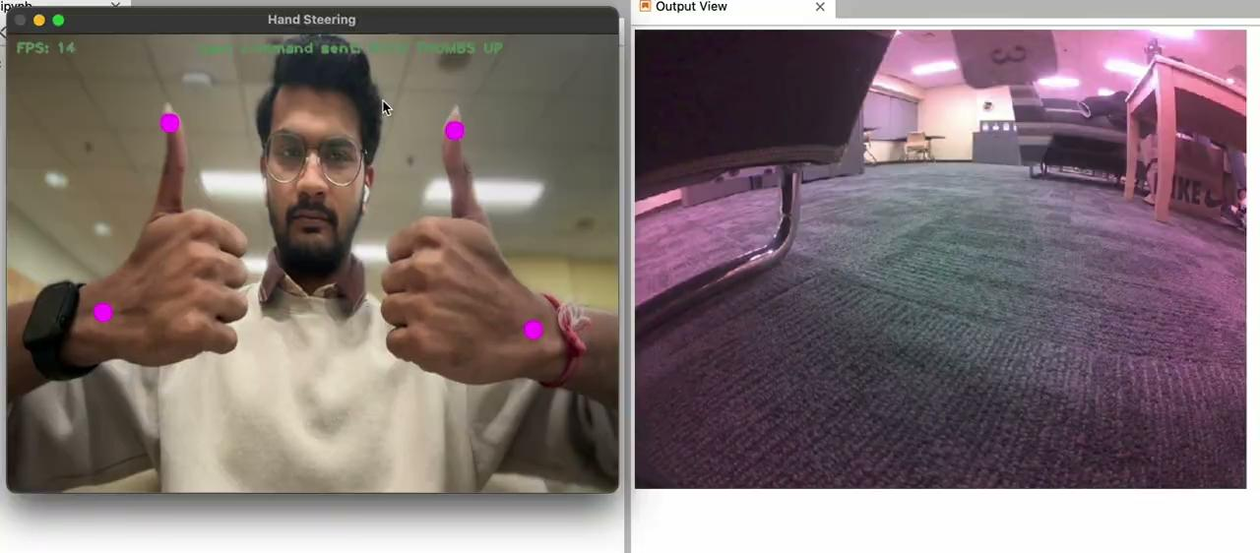
Demo
Link: https://drive.google.com/file/d/1hnb25JeQzMP0U4jyhdVHA5woU9TRMHZe/view?usp=sharing

Slide 6
Future Developments
Enhanced Gesture Library
Integration with AI Assistants
Collision Avoidance
Voice and Gesture Control
Multi-Robot Coordination

Slide 7
Thank You!

